Slide 1
Sentiment Classification:
Fields Considered:
Input Variable – Message, Message Type
Output Variable – Sentiments (Positive/ Negative/ Neutral)
Data and Observation:
We found ~93% of the messages to be in ‘English’ Language from the ‘Language’ field. Hence, we have considered only ‘English’ language messages for this analysis
The majority of the data is around ‘Twitter’ and ‘Web’, from the below figure:

Slide 2
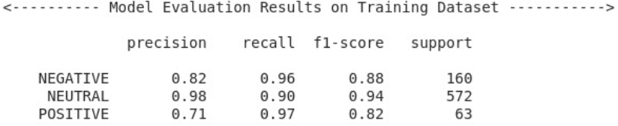
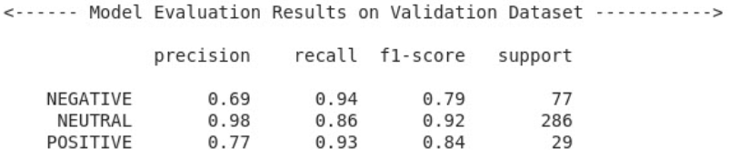
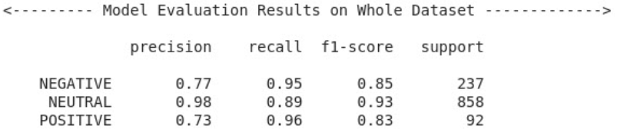
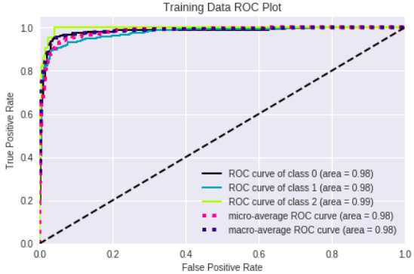
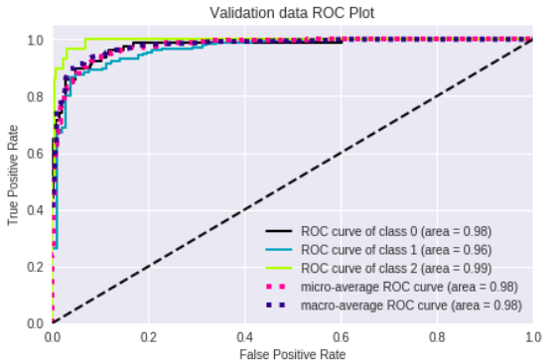
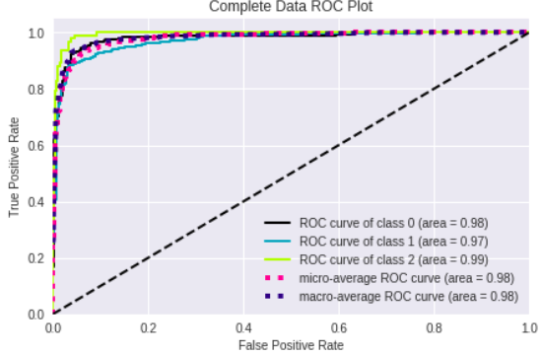
Methodology:
Data Pre-processing
Removal of Stop Wards, Special Character, URL Links and Emoticons
Lemmatization using NLTK Lemmatizer
Modeling
Auto Feature Generation using Doc2Vec and One-Hot Encoding
Applied SMOTE technique for Unbalanced Data
GBM with hyper-parameter tuning for ‘Sentiment’ Classification
Results:
Train Data
Validation Data
Whole Data

